Slide 1
The Art of War
Picasso’s Guernica

Slide 2
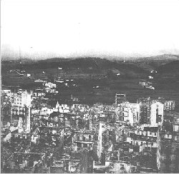
Pablo Picasso, a Spanish painter, chose to use this bombing of the town as the theme for a very large painting.

Slide 3
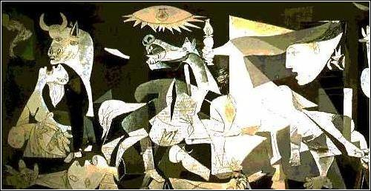
The painting is almost the size of one wall of your classroom. It is done in black, grey, and white.

Slide 4
The images are startling. Picasso tried to be secretive about the painting’s meaning…but we have clues about why he included certain drawings.

Slide 5
He had made drawings earlier where he did explain their meanings…

Slide 6
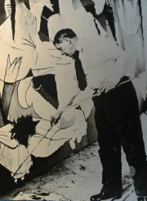
Guernica took months to paint. It was displayed in Paris. Let’s take a look at some of the symbolism…

Slide 7
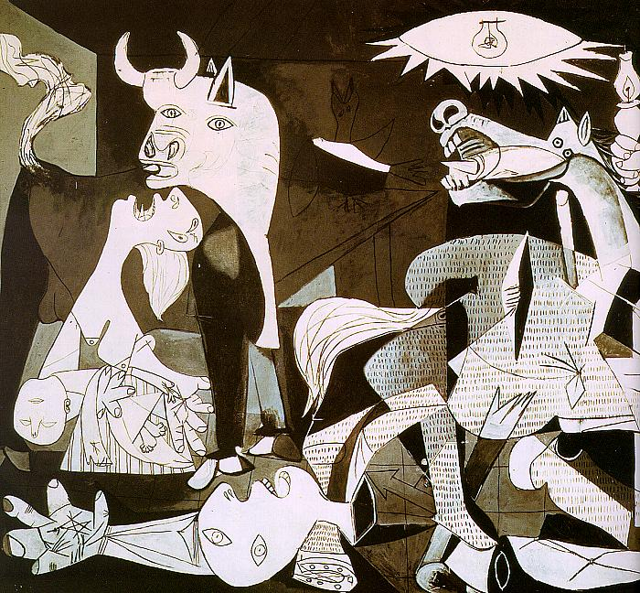
The Bull in the painting is a symbol of Spain. The bull “observes” the destruction in front of him.

Slide 8
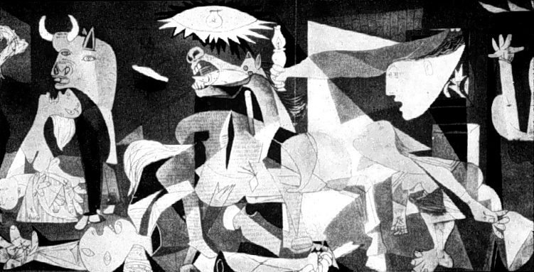
The fallen warrior is from the legend of Parsifal—whose sword breaks in half at the crucial moment of battle.

Slide 9
The fallen warrior is also laid out in a crucifix position…

Slide 10
The slashes on the horse are representative of newsprint—the newspaper that lists those who have died.

Slide 11
The light in the middle of the painting may mean violence…

Slide 12
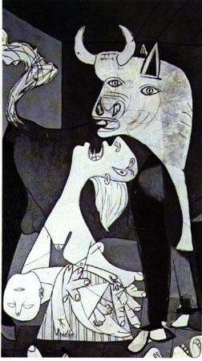
There are terrible images—a woman holding a dead child.

Slide 13
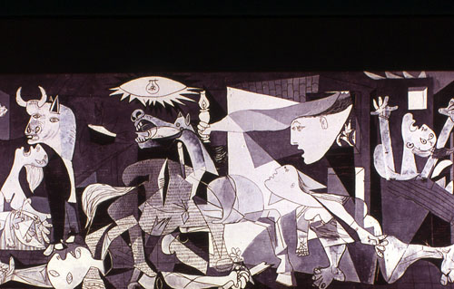
A person burning in a fire…

Slide 14
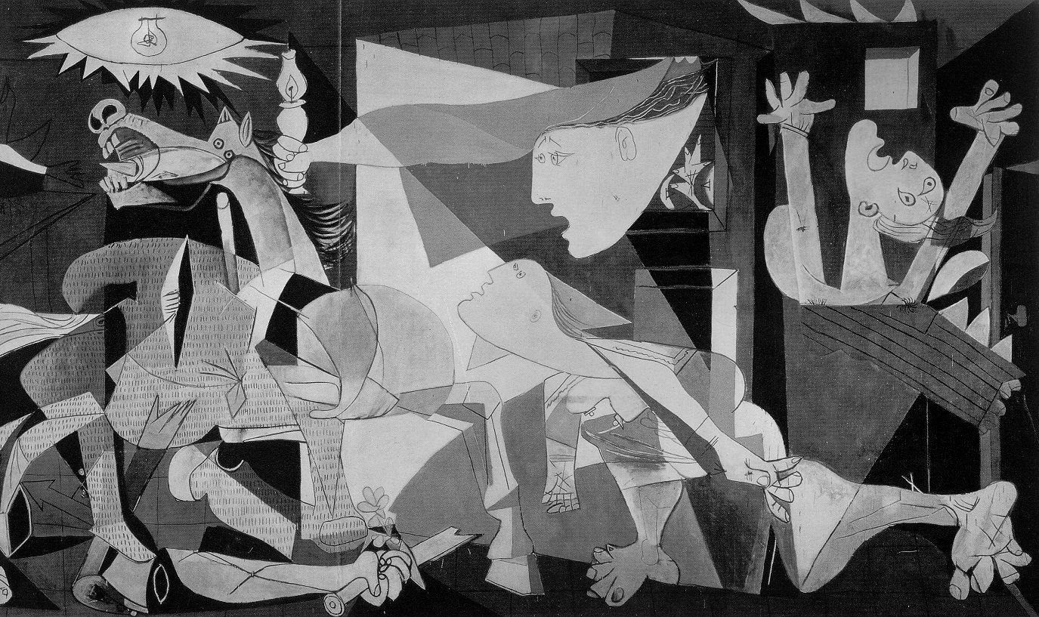
Some say that Picasso painting an open door so that he could “escape” from the violence.

Slide 15
Guernica has come to be one of the most famous paintings of our modern age--

